Slide 1
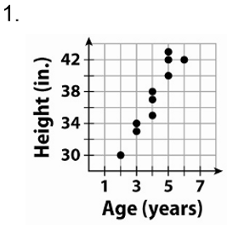
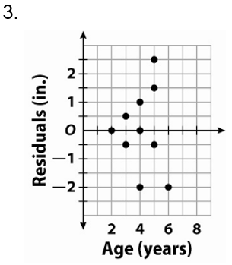

Slide 2
Review for Test 2

Slide 3
Problem 1:
Find the point of intersection for the system $\left\{\begin{aligned}y=x+3 \\ 3x−2y=5\end{aligned}\right. b$y using substitution.

Slide 4
Problem 1A:
Find the point of intersection for the system $\left\{\begin{aligned}x=−3y+6 \\ 2x+6y=12\end{aligned}\right. b$y using substitution.

Slide 5
Problem 2:
One high-speed Internet provider has a $30 setup fee and charges $40 per month. Another provider has a $60 setup fee and charges $30 per month. In how many months will the cost be the same? How much money will the cost be?

Slide 6
Problem 3:
Find the solution for the system by using the elimination method.
$\left\{\begin{aligned} 3x−5y=−13 \\ 5x−6y=−17\end{aligned}\right.$

Slide 7
Problem 3a:
Find the solution for the system by using the elimination method.
$\left\{\begin{aligned} 6x−5y=7 \\ 7x+6y=20\end{aligned}\right.$

Slide 8
Problem 3B:
Find the solution for the system by using the elimination method.
$\left\{\begin{aligned} 3x−y=−2 \\ 9x−3y=−6\end{aligned}\right.$

Slide 9
Problem 4:
The school that Shanice goes to is selling tickets to the annual dance competition. On the first day of ticket sales the school sold 4 adult tickets and 12 student tickets for a total of $204. The school took in $174 on the second day by selling 10 adult tickets and 6 student tickets. What is the price each of one adult ticket and one student ticket?

Slide 10
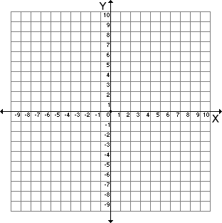
Problem 5:
Find the solutions for the system of inequalities.
$\left\{\begin{aligned}x+2y>2 \\ −x+y≤4\end{aligned}\right.$

Slide 11
Problem 5a:
Find the solutions for the system of inequalities.
$\left\{\begin{aligned}y≥−\frac{3}{2}x+1 \\ y<\frac{1}{2}x−3\end{aligned}\right.$

Slide 12
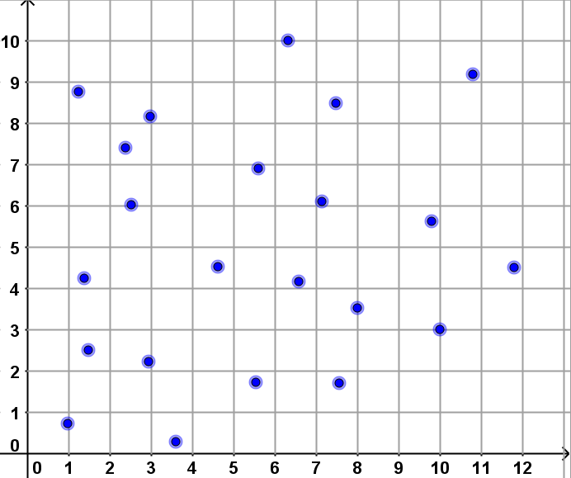
Problem 6:
Given the scatter plot. Estimate the type of correlation and the correlation coefficient?
Positive Correlation
Negative Correlation
No Correlation
$−1$
$−0.5$
$0$
$0.5$
$1$

